Slide 1

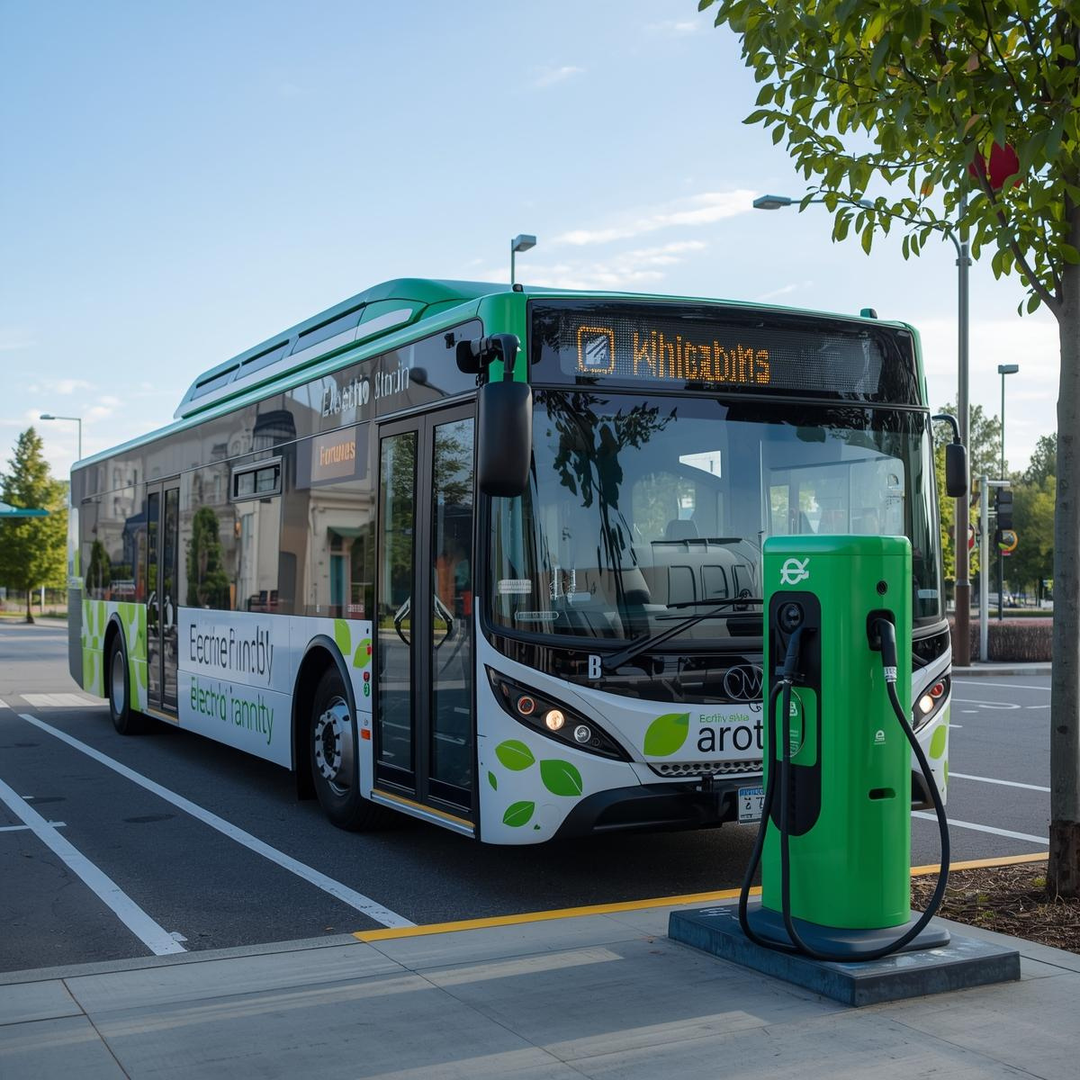
Dynamic Analysis ​of Suspension System​
of An Electric Bus​

Slide 2

INTRODUCTION
Dynamic analysis ensures optimal ride comfort, stability, and safety
1
2
Suspension systems are vital for vehicle safety, comfort, and performance, especially with heavy battery packs and unique chassis designs.
It helps evaluate ride quality and design of springs, dampers, and actuators.
3
Suspension isolates the bus body from road irregularities and transmits steering and braking loads.
4

Slide 3
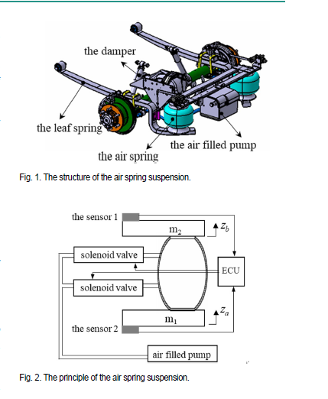
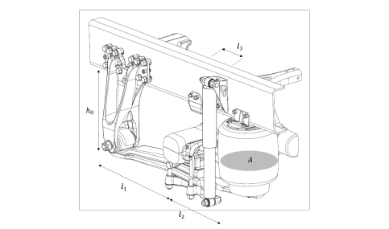
PHYSICAL MODEL DEVELOPMENT​

Slide 4
SYSTEM COMPONENETS
SUSPENSION ELEMENTS
Sprung Mass Components:​
  Vehicle Body: Chassis frame, battery pack, passenger cabin​
  Powertrain: Electric motor, transmission, power electronics​
  Payload: Passengers, driver, interior equipment​
  Total Sprung Mass (Ms): 9,000 – 13,000 kg (for 12m electric bus)​
Unsprung Mass Components:​
  Axle assembly, wheel hub, brake assembly​
  Wheel & Tire (rim + tire)​
  Suspension mounts (lower control arm, knuckle)​
  Total Unsprung Mass (Mu): 250 – 400 kg per wheel​
Primary Spring : Air suspension bellows or coil spring​
  Stiffness: 300,000 – 665,000 N/m​
  Natural frequency: 1 – 2 Hz​
Damper (Shock Absorber) : Hydraulic or magnetorheological​
  Damping coefficient: 12,000 – 50,000 Ns/m​
  Damping ratio: 0.2 – 0.4
​
Tire Characteristics​
  Tire stiffness Kt = 500,000 – 1,000,000 N/m​
  Tire damping Ct ≈ 10–15% of suspension damping​
  Tire sizes 245/75 R16 to 275/70 R22.5​

Slide 5
SYSTEM BEHAVIOUR :
Suspension acts as multi-stage vibration isolation:
STAGE | FUNCTION
Tire | First isolation from road irregularities
Suspension | Main isolation between sprung & unsprung masses
Load path | Road → Tire → Unsprung mass → Suspension → Sprung mass

Slide 6
Simplified Model Development
Represents one corner of vehicle
Component | Symbol and units | Meaning
Sprung mass | Ms (kg) | 1/4 vehicle body mass
Unsprung mass | Mu (kg) | Wheel + hub assembly
Suspension spring | Ks (N/m) | Suspension stiffness
Suspension Damper | Cs (Ns/m) | Suspension damping
Tire spring | Kt (N/m) | Tire stiffness
Tire Damping | Ct (Ns/m) | Tire damping

Slide 7
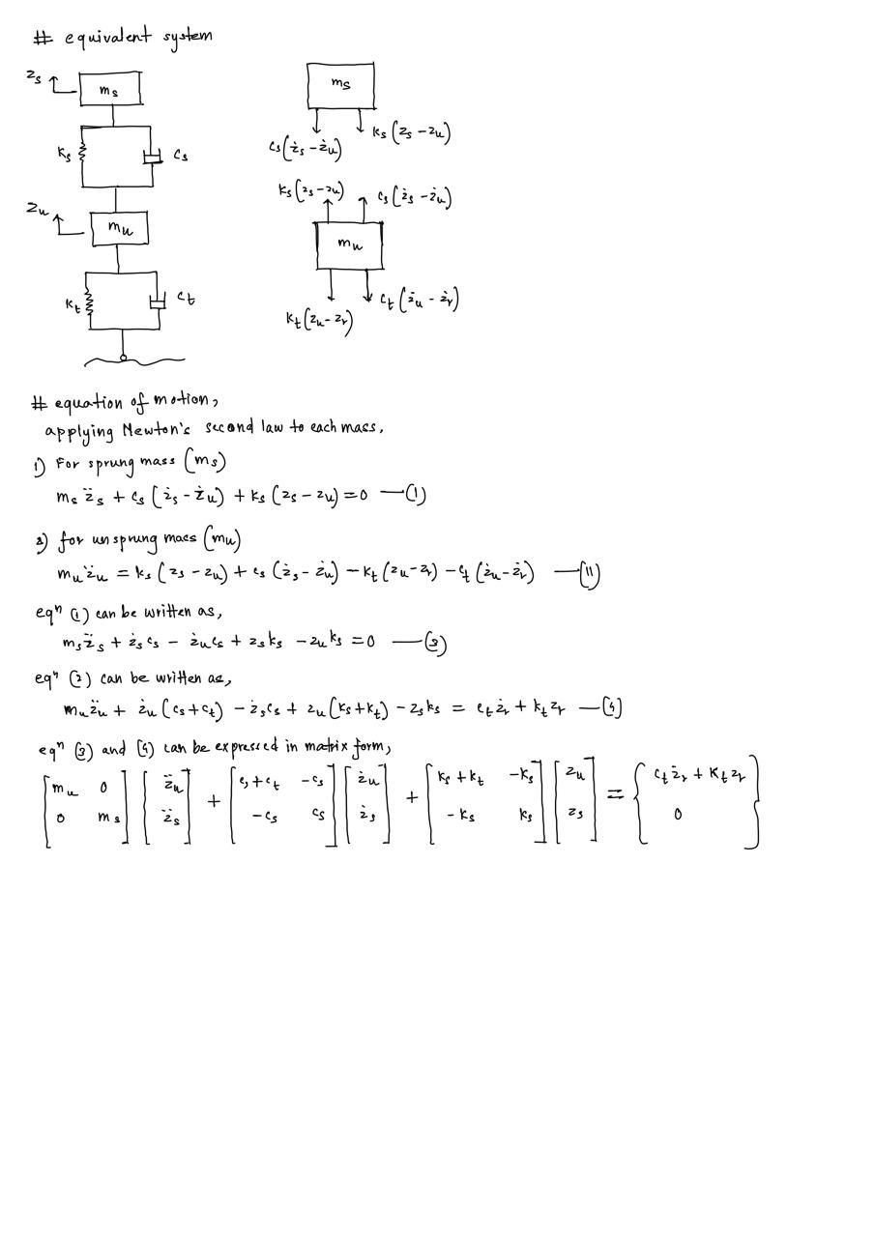
Motion Variables
  Displacements: Zs(t), Zu(t), Zr(t)​
  Velocities : Żs(t), Żu(t)​
  Accelerations: Z̈s(t), Zu(t)
Where:​
  Zs = sprung mass displacement​
  Zu = unsprung mass displacement​
  Zr = road input profile

Slide 8



Natural Frequencies and Damping Ratios
Sprung Mass Natural Frequency:
Unsprung Mass Natural Frequency:
Damping Ratio:
  For passenger comfort, fs should be in the range of 1.0 - 2.0 Hz.
  Typically, fu is in the range of 10 - 15 Hz.
  Optimal damping ratio for passenger vehicles: ζ = 0.2 - 0.4

Slide 9
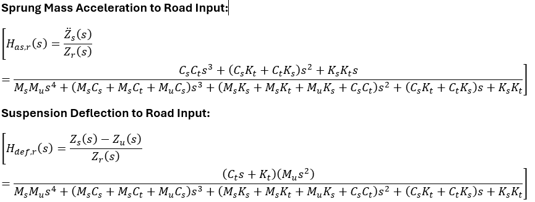

Transfer Functions
Transmissibility:

Slide 10
Mathematical model implementation
System parameter values
parameter​ | value
Ms​ | 2500 – 3250 kg​
Mu​ | 300 kg​
Ks​ | 250,000 - 400,000 N/m​
Cs​ | 20,000 Ns/m​
Kt​ | 800,000 N/m​
Ct​ | 2,000 Ns/m​

Slide 11
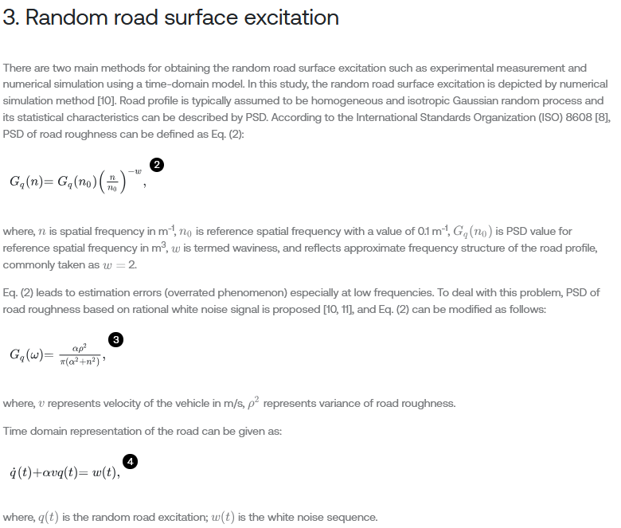
  Random: ISO 8608 Class B
Road excitation :​
  Bump : sinusoidal, 0.05m amplitude, wavelength 5m
  Random: ISO 8608 Class B
Reference :https://www.extrica.com/article/20271

Slide 12
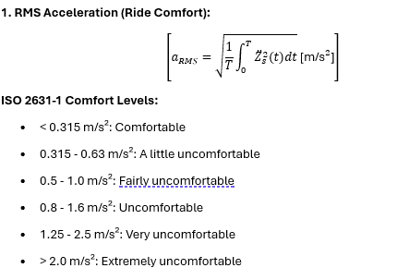
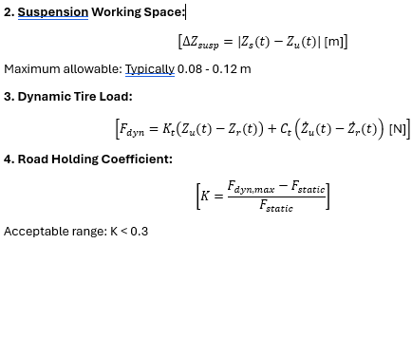
Performance Metrics

Slide 13
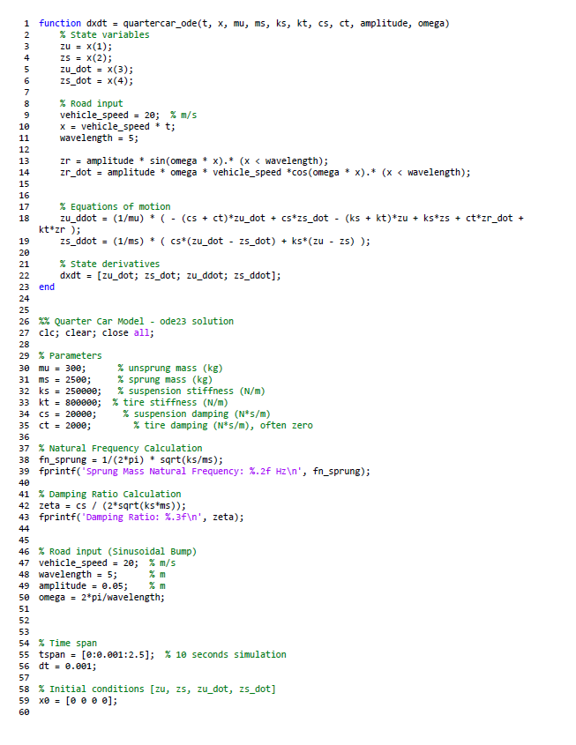
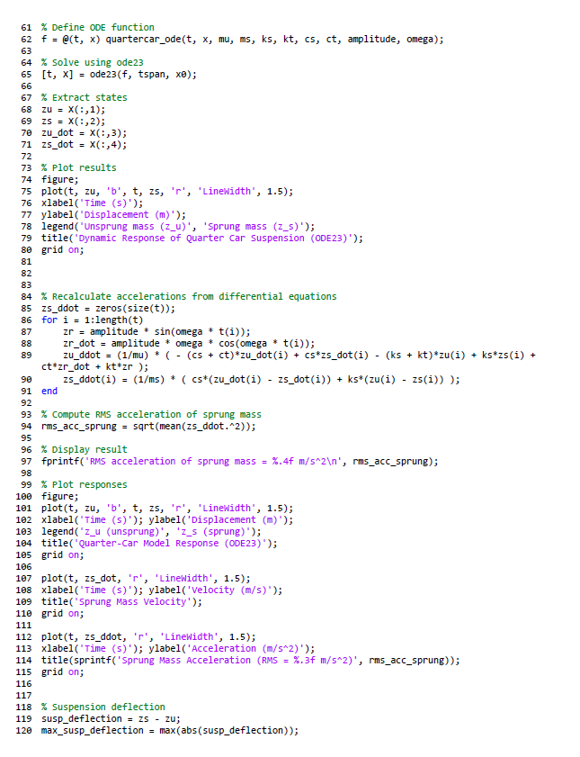
MATLAB CODE​
Link to matlab code: ​
https://drive.google.com/file/d/1tLqO5NefZr00L9HyUYItyZSDnxJa9833/view?usp=drivesdk

Slide 14
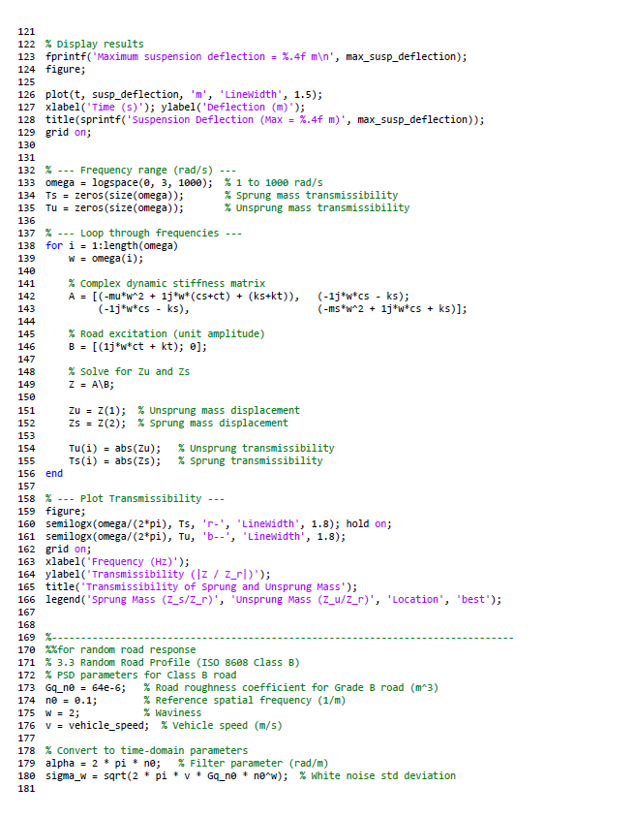
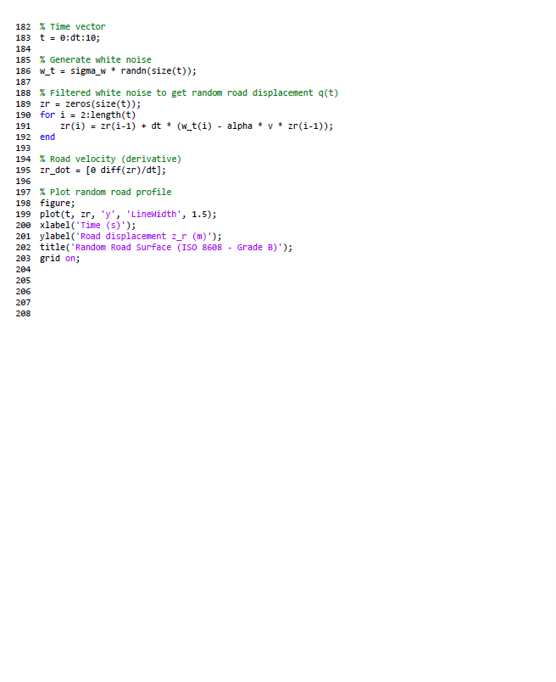

Slide 15
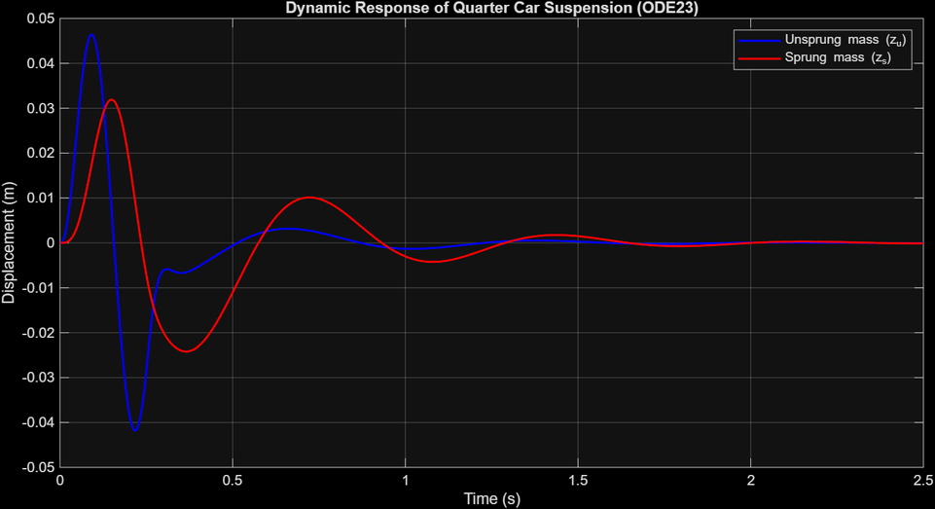
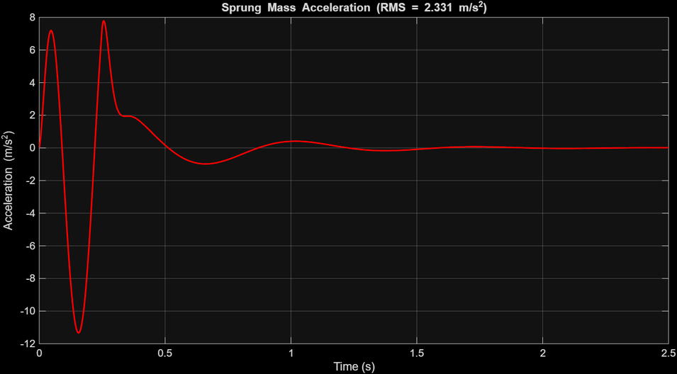
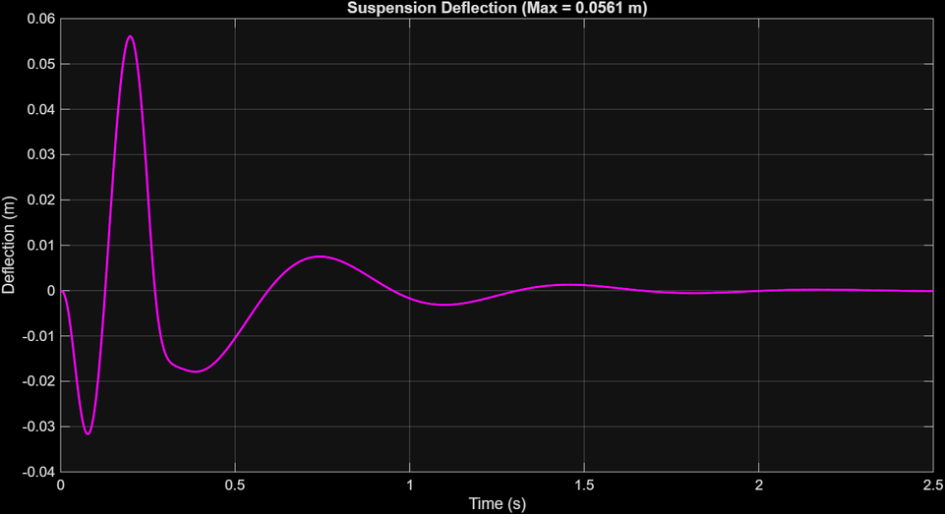
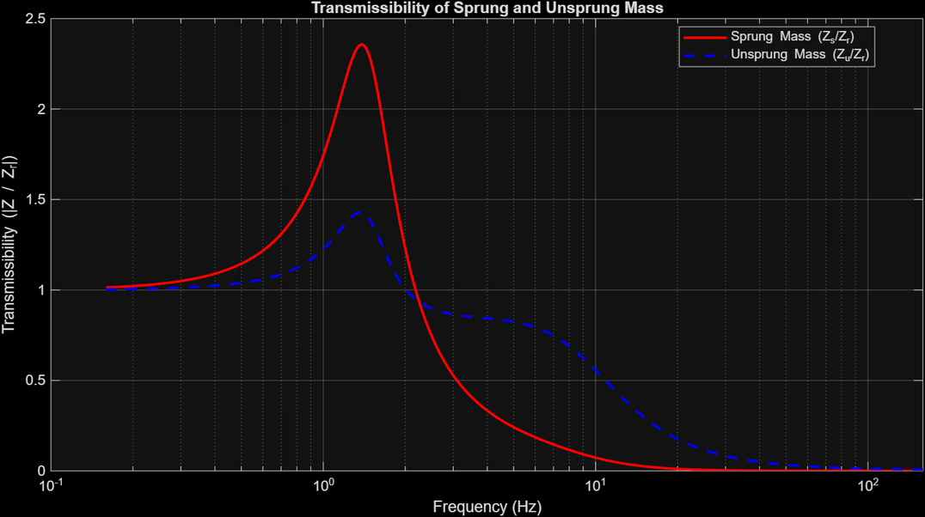
Plots
4

Slide 16
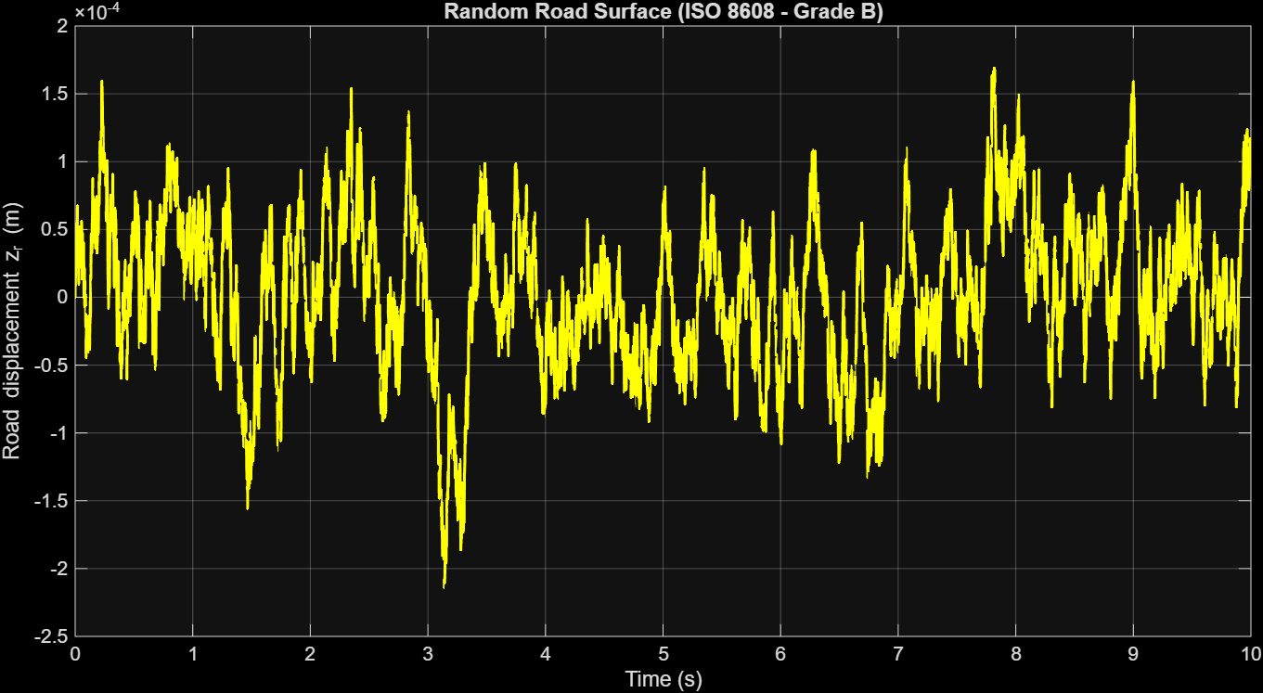
Random Road Surface plot

Slide 17
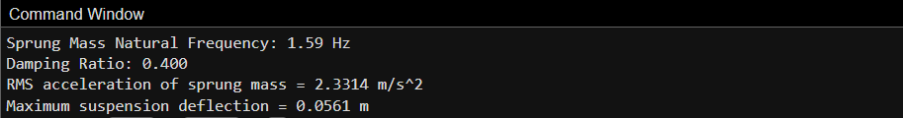
Results
Conclusion
  The 2-DOF quarter-bus model provides valuable insight into ride dynamics for electric buses.​
  Suspension stiffness/damping tuning can significantly impact comfort and safety​
  Increased unsprung mass for in-wheel motors may require stiffer/active suspensions.​
  Future work: Model pitch/roll (half/full-bus), integrate field data, simulate active suspension strategies.​
References
  Sekulić, D., et al. (2014). Effects of Suspension Stiffness and Damping on Bus Ride Quality. International Journal of Vehicle Systems Modelling and Testing, 9(3), 209-225.
  Long, X., et al. (2018). Dynamic Modeling and Ride Comfort Analysis of a Full Vehicle Bus Model. Journals of Vehicle Engineering and Technology, 2018(3), 45-59.​
  https://journals.sagepub.com/doi/10.1155/2014/269721
4

Slide 18
THANK YOU
Presented by :​
B . DEEPIKA (230103026)​
BHASKAR SONOWAL (230103027)​
BIBUNGSHA BORO (230103028)​
C . LIKITHA REDDY (230103029)​

